Slide 1
FLOWER: A FRIENDLY FEDERATED LEARNING FRAMEWORK
Cited by 542
Daniel J. Beutel/Taner Topal/Akhil Mathur/Xinchi Qiu/
Javier Fernandez-Marques/Yan Gao/Lorenzo Sani/Kwing Hei Li/
Titouan Parcollet/Pedro Porto Buarque de Gusmao/Nicholas D. Lane

Slide 2
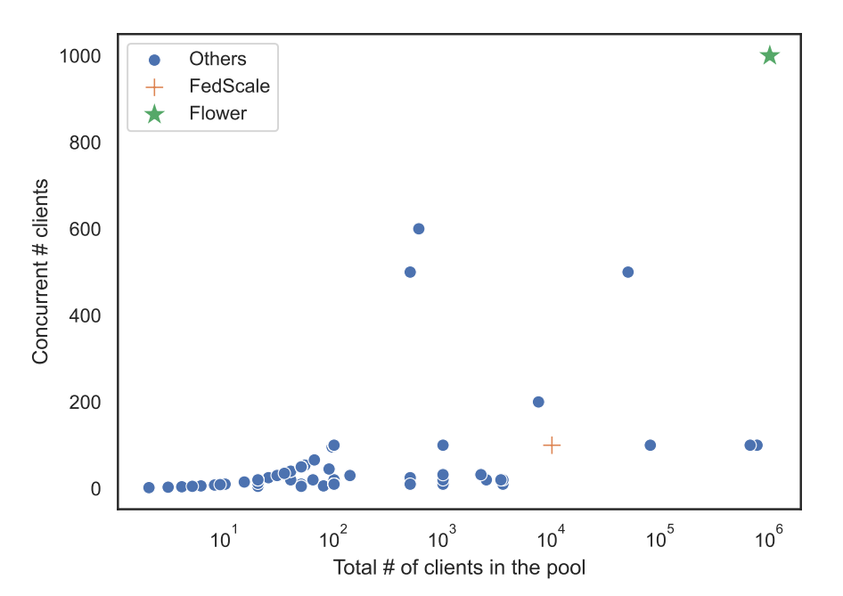
Problems and Solutions
Federated Learning
Local parameters update to a shared prediction model on each edge device.
Sending the local parameter updates to a central server for aggregation.
Receiving the aggregated model back for the next round of local updates.
The client selection and parameter aggregation algorithms impact the accuracy and training time of models trained.
Few research papers use populations of more than 100 clients.

Slide 3
Problems and Solutions
Contributions:
Present Flower, a novel FL framework that supports large-cohort training and evaluation, both on real edge devices and on single-node or multi-node compute clusters.
Describe the design principles and implementation details of Flower.
Using Flower , present experiments that explore both algorithmic and system-level aspects of FL on five machine learning workloads with up to 15 million clients.
Flower is open-sourced under Apache 2.0 License and adopted by major research organizations in both academia and industry.

Slide 4
Framework
Flower:
Flower, a novel end-to-end federated learning framework that enables a more seamless transition from experimental research in simulation to system research on a large cohort of real edge devices.
Use Cases
Scale experiments to large cohorts.
Experiment on heterogeneous devices.
Transition from simulation to real devices.
Multi-framework workloads.
Design Goals
Scalable.
Client-agnostic.
Communication-agnostic.
Privacy-agnostic.
Flexible.

Slide 5
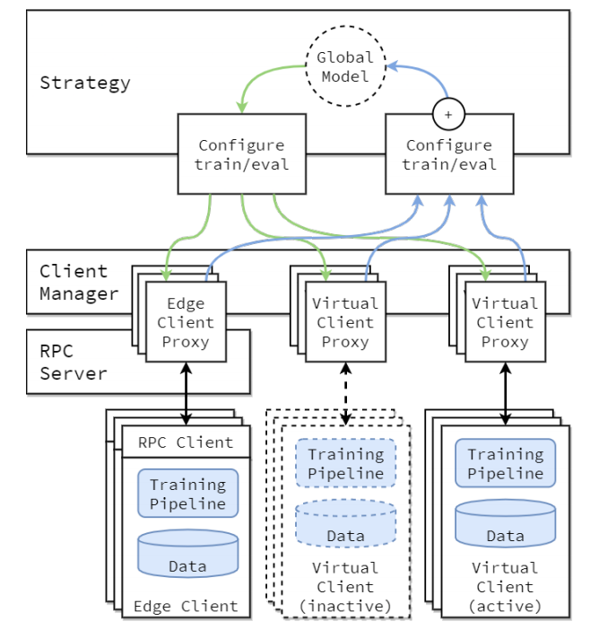
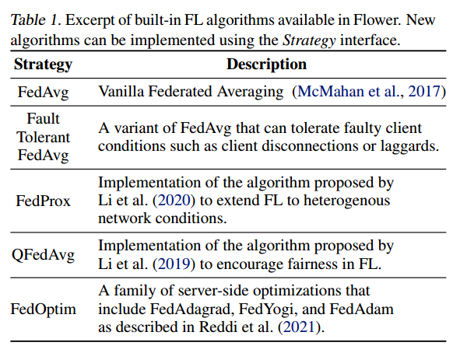
Framework
Core Framework Architecture

Slide 6
Framework
Virtual Client Engine
Built into Flower is the Virtual Client Engine (VCE): a tool that enables the virtualization of Flower Clients to maximise utilization of the available hardware.
Edge Client Engine
Flower provides a low-level integration by directly handling Flower Protocol messages on the client.
Secure Aggregation
Flower provides implementation of both SecAgg and SecAgg+ protocols for a semi-honest threat model.

Slide 7
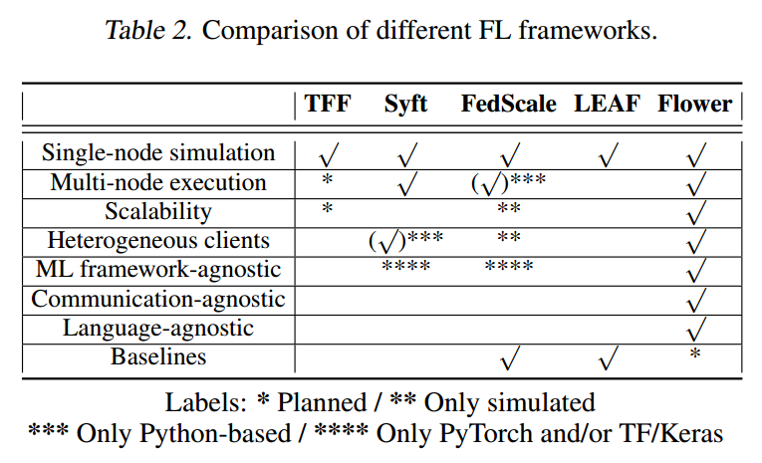
Framework
FL Framework Comparison

Slide 8
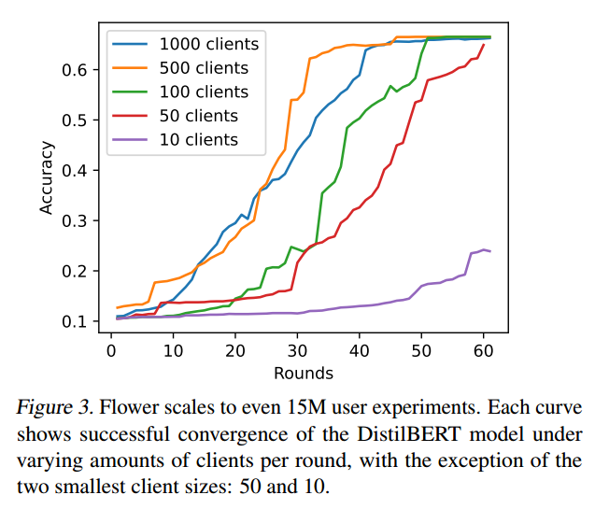
Framework Evaluation
Framework Evaluation
Large-Scale Experiment
Experimental Setup.
Amazon’s Book Reviews Dataset which contains over 51M reviews from 15M different users.
Each review from a given user contains a textual review of a book along with its given rank (1-5).
For each experiment fix the number of clients being sampled in each round (from 10 to 1000) and aggregate models using FedAvg.
Test the aggregated model after each round on a fixed set of 1M clients.
Using two NVIDIA V100 GPUs on a 22-cores of an Intel Xeon Gold 6152 (2.10GHz) CPU.

Slide 9
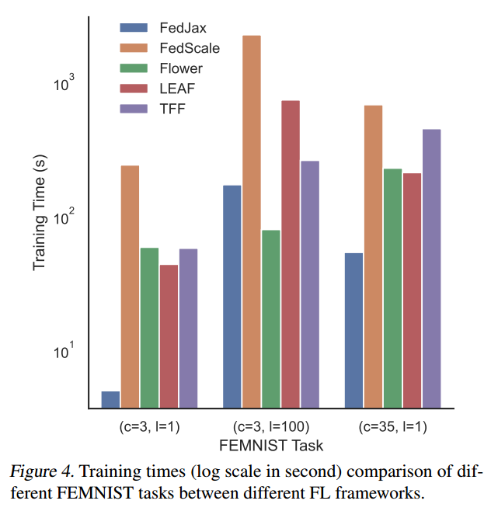
Framework Evaluation
Framework Evaluation
Single Machine Experiments
Experimental Setup.
To correctly classify characters from the FEMNIST dataset.
The total number of rounds and total number of clients are kept constant at 2000 and 179.
Using eight cores of an Intel Xeon E5-2680 CPU (2.40GHz) equipped with two NVIDIA RTX2080 GPUs and 20GB of RAM.

Slide 10
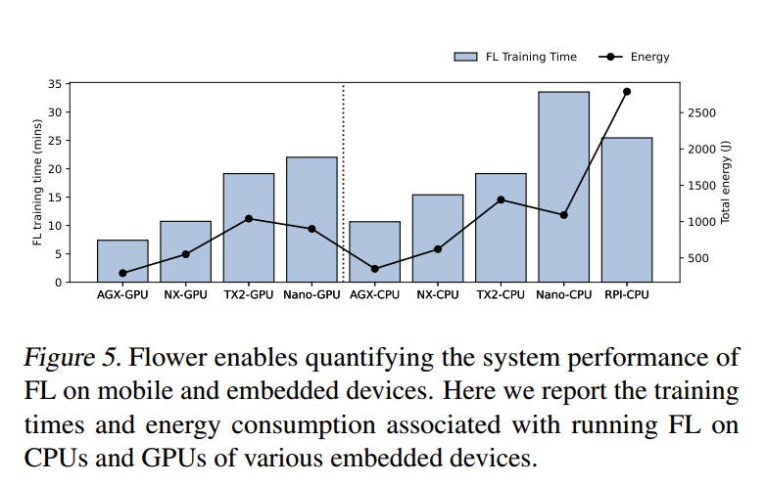
Framework Evaluation
Framework Evaluation
Flower enables FL evaluation on real devices
Experimental Setup 1.
Python-based Flower clients are implemented for Nvidia Jetson series devices (Jetson Nano, TX2, NX, AGX) and Raspberry Pi.
Trained using TensorFlow as the ML framework on each client.
Android smartphones currently do not have extensive on-device training support with TensorFlow or PyTorch.

Slide 11
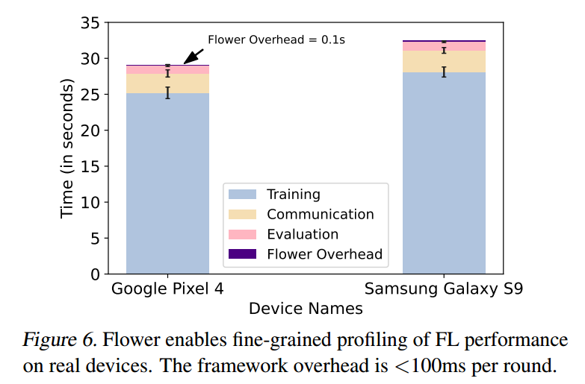
Framework Evaluation
Framework Evaluation
Flower enables FL evaluation on real devices
Experimental Setup 2.
Deploy Flower on 10 Android clients to train a model with 2 convolutional layers and 3 fully-connected layers on the CIFAR10 dataset.
TensorFlow Lite is used as the training ML framework on the devices.
Measure the time taken for various FL operations, such as local SGD training, communication between the server and client, local evaluation on the client, and the overhead due to the Flower framework.

Slide 12
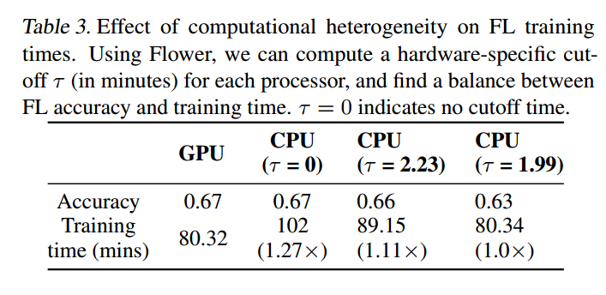
Framework Evaluation
Framework Evaluation
Realism in Federated Learning
Computational Heterogeneity across Clients.
Use a Nvidia Jetson TX2 as the client device, which has a Pascal GPU and six CPU cores.
Train a ResNet18 model on the CIFAR-10 dataset in a federated setting with 10 total Jetson TX2 clients and 40 rounds of training.

Slide 13
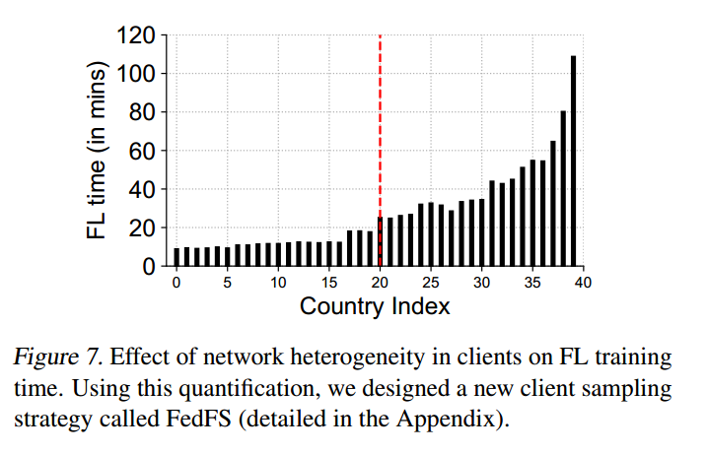
Framework Evaluation
Framework Evaluation
Realism in Federated Learning
Heterogeneity in Network Speeds.
An experiment with 40 clients collaborating to train a 4-layer deep CNN model for the FashionMNIST dataset.

Slide 14
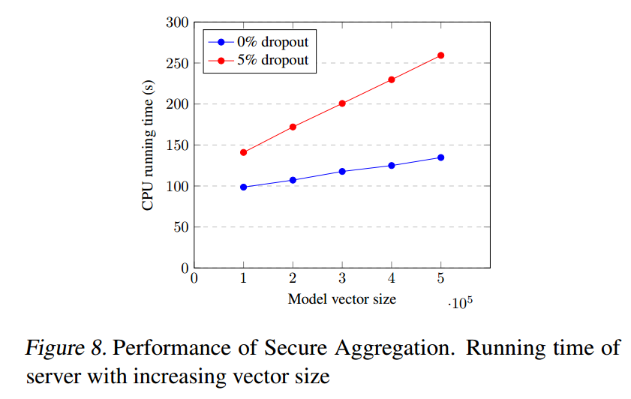
Framework Evaluation
Framework Evaluation
Secure Aggregation Overheads
Experiment Setup.
The FL simulations run on a Linux system with an Intel Xeon E-2136 CPU (3.30GHz), with 256 GB of RAM.
All entries of local vectors are of size 24 bits.

Slide 15
Innovation and Future
Innovation:
Flower – a novel framework that is specifically designed to advance FL research by enabling heterogeneous FL workloads at scale.
Through the provided abstractions and components, researchers can federated existing ML workloads (regardless of the ML framework used) and transition these workloads from large-scale simulation to execution on heterogeneous edge devices.
Target both scale and systems heterogeneity by scaling FL up to 15M clients, providing head-to-head comparison between different FL frameworks for single-computer experiments.
Future:
Flower is open-sourced under Apache 2.0 License.
More community contributions to it.

Slide 16
END

